Slide 1
Integrity Constraints
They are rules that relation should satisfy for a relational instance.
Domain Constraints
Unique
Null
Not Null
Check
Key Constraints

Slide 2
Key Constraints
EMP_ID | EMP Name | DEPT_ID
1 | Dr. Imran | 1
2 | Dr. Wajahat | 2
Primary Key Constraints
Rule that specifies a field to be a primary key.
A Primary Key is a field (Column) which is used to identify the whole record.
Composite Key Constraints
Rule specifies one or more field as a primary key.
Foreign Key Constraints
Rule specifies a field to be a foreign key
Foreign key specifies a field which can be used to relate a table with other table.
DEPT_ID | DEPT_Name
1 | CS
2 | MS

Slide 3
Conversion of ER Model to Tables
Entity sets to Tables.
Each Entity set can be represented into a separate relation or table. i.e. the entity set name is considered as the table name.
Each attribute is represented as the field or column in the table.
Key attribute is represented as the primary key for that table.

Slide 4
Conversion of ER Model to Tables
If there is Mulitvalued attribute then a separate table has to be represented only for that mulitvalued attribute with each field representing different values that the attribute can hold for an entity instance and a separate field which represents the primary key of the parent table must also be represented.
If there is a composite attribute then each of its subcomponent are represented as fields in that table.

Slide 5
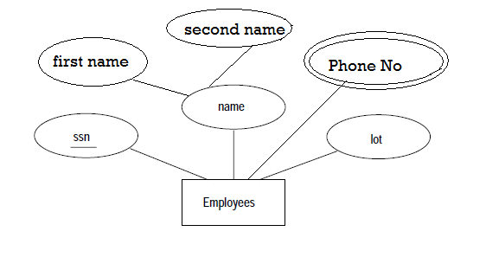
Example

Slide 6
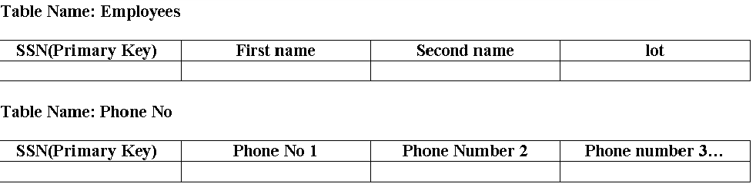
Table

Slide 7
Conversion of ER Model to Tables
Relationship sets to tables (Without Constraints)
A relationship set is also represented as a table in relational model with fields as the key attributes of the participating entity set.
Descriptive attributes of the relationship set is also represented as a field in the table.

Slide 11
Conversion of ER Model to Tables
Translating ER diagrams with Generalization and Specialization.
For each sub entities a separate relation is created with fields as attributes of the sub entity and another additional field as the primary key of the parent entity set.

Slide 13
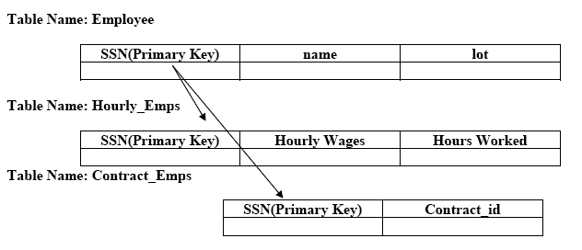

Slide 14
Conversion of ER Model to Tables
Translating ER diagrams with Aggregation
Representing aggregation is easy as the relational model doesn’t have different representation for relationship set and an entity set.

Slide 17
Relational algebra….
Relational algebra is a mathematical concept used in designing efficient Queries.
Queries are questions asked to the database for extracting data or to perform some action in the database.
When data is requested from the database using a query
What data is to be requested.
From which source the data is to be requested
Are clearly specified

Slide 18
Relational algebra operation
The relational algebra operation are to describe the formats of the query design that we use in SQL.
Some Basic Operations include
Selection
Projection
Union
Difference
Cartesian Product……

Slide 19
Selection(σ)
Used to select some rows from a table
Format
σ (Predicate) (R)
Predicate can be a condition on fields like name>10
R is a relation
For Example
σAge = Weight (Person)

Slide 20
Projection(π)
Projection is used to select only needed columns
Format
π (a1, a2, a3….) ( R )
For Example
π (Name, Weight) (Person)

Slide 21
Rename(ρ)
Used to give different name to the relation
Format
ρ a / b(R)
a and b are attribute names
R is a relation
For Example
ρ EmployeeName / Name(Employee)

Slide 22
Union (U)
Used to join two relation where the row with same values will be selected only once
Format
π _{(a1, a2, a3….)} ( R1 ) U π _{(a1, a2, a3….)} ( R2 )
For Example
π (Employee Number, Employee name, Address, GSM) (IT-Student ) U
π (Employee Number, Employee name, Address, GSM) (Bus-Student )
The Union operation can be performed only on compatible relations

Slide 23
Intersection(∩)
Used in two relation where the rows with the same value is only selected.
Format
π (a1, a2, a3….) ( R1 ) ∩ π (a1, a2, a3….) ( R2 )
For Example
π (Employee Number, Employee name, Address, GSM) (IT-Student ) ∩
π (Employee Number, Employee name, Address, GSM) (Bus-Student )
Intersection can be performed only on compatible relation
Unfortunately, MySQL does not support the INTERSECT operator.

Slide 24
Difference(-)
Used in two relation where the rows from the first relation is displayed excluding the rows with same values.
Format
π (a1, a2, a3….) ( R1 ) - π (a1, a2, a3….) ( R2 )
For Example
π (Employee Number, Employee name, Address, GSM) (IT-Student )
-
π (Employee Number, Employee name, Address, GSM) (Bus-Student )
The Difference can also be performed only on compatible relation

Slide 25
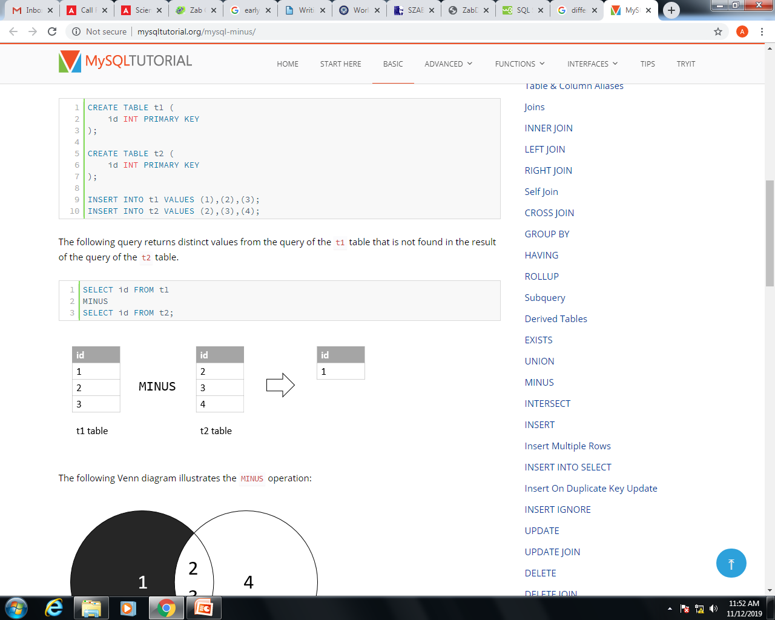
Difference(-)
The Difference compares the results of two queries and returns distinct rows from the result set of the first query that does not appear in the result set of the second query.

Slide 26
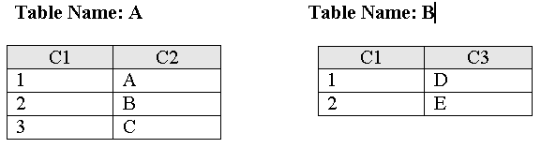
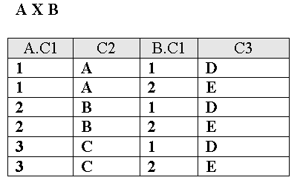
Cartesian Product / (X) Cross Product
Used between more than one table where the first row from the first table is combined with every row in the second table and this combination is repeated with each row of the first table.
For Example

Slide 27
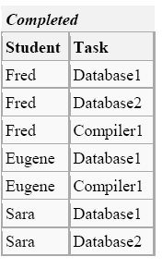
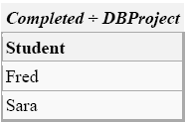
Division ÷
Division operation uses two tables and the result will be the columns excluding the common fields and rows that have same values in common fields

